Slide 1






PINDUODUO
Why Did PDD Take Off ?
— A platform economics-based
perspective.
April 18th, 2025
Group 1: Kai Ren, PeiHua Ji, JunWen Luo, FeiFan Xu,
Lei Cheng, Chang Li
Team Up, Price Down!
Team Up for Savings | Deals | Welcome Surprises !

Slide 2

PINDUODUO
PART O1
Platform
Introduction
PART O2
Theoretical Analysis
PART O3
Extension
PART O4
Conclusion
Team Up, Price Down!
Team Up for Savings | Deals | Welcome Surprises !

Slide 3



PART 01
Platform Introduction
PINDUODUO
Team Up, Price Down!
Team Up for Savings | Deals | Welcome Surprises !

Slide 4



1.1 Take Off of PDD
Pinduoduo (PDD) is a mainstream e-commerce platform on China's mobile Internet.
It is a third-party social e-commerce platform that specializes in C2M group shopping.
Users can initiate group purchases with friends, family, neighbors, etc. to buy goods at lower prices.
Founder
Huang Zheng
Created
September 2015
Revenue
GMV
Number of Active Buyer
Taking Off !
Fig 1.1 PDD Revenue and Growth Rate
(2016 – 2022 Q3)
Fig 1.2 PDD GMV and Growth Rate
(2017 – 2021)
Fig 1.3 PDD Active Buyer and Growth Rate
(2017 – 2021)

Slide 5
1.2 Development Path
2021
2019
“Ten Billion Agricultural Research” program was announced.
In June, launched a “10 billion yuan subsidy”. GMV breaks through “trillion”.
2017
2015
September, its annual active buyers exceeded 200 million.
April, Pinhaohuo was launched on WeChat.
2023
2020
Market capitalization surpassed Alibaba's for the first time.
DuoDuo Grocery was launched in August.
The number of annual active buyers on the platform reached 730 million.
2018
2016
Officially listed on NASDAQ in July.
2024
September, Pinduoduo official account launched. Two weeks fans broke ten thousand.
“Ten Billion Relief” program was announced.
PDD has achieved steady growth and a rapid rise !
Data Source: MinSheng Securities (2025.01.17)

Slide 6
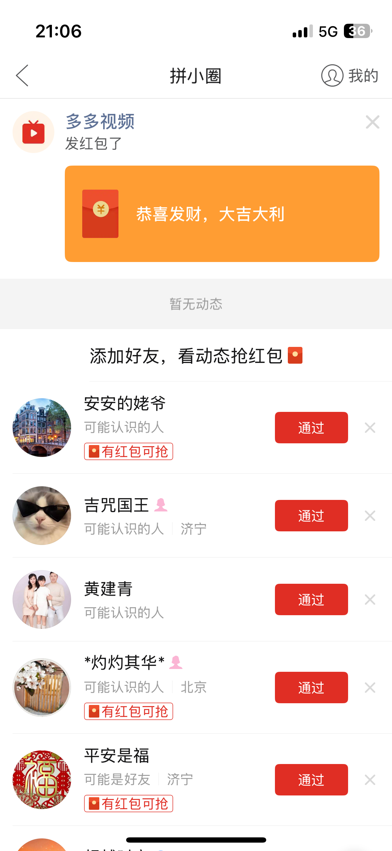
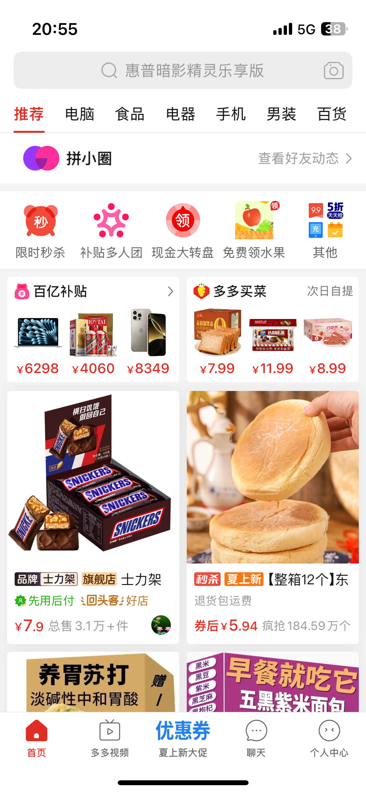
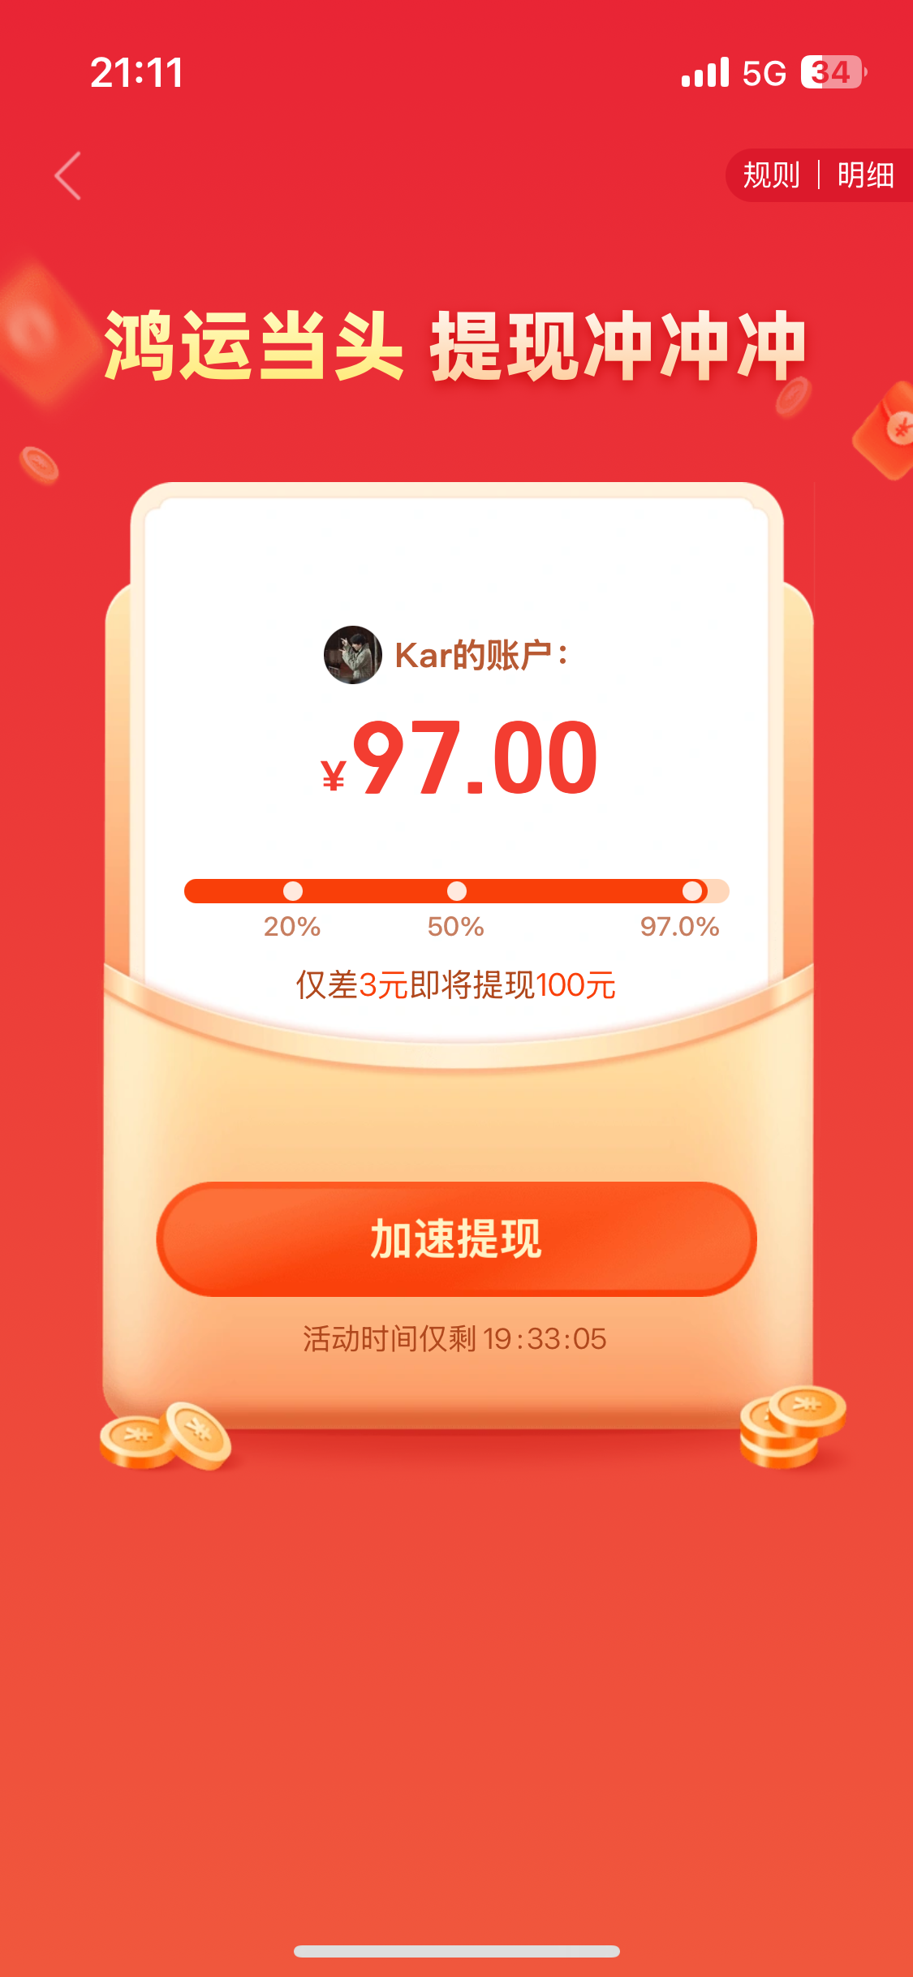
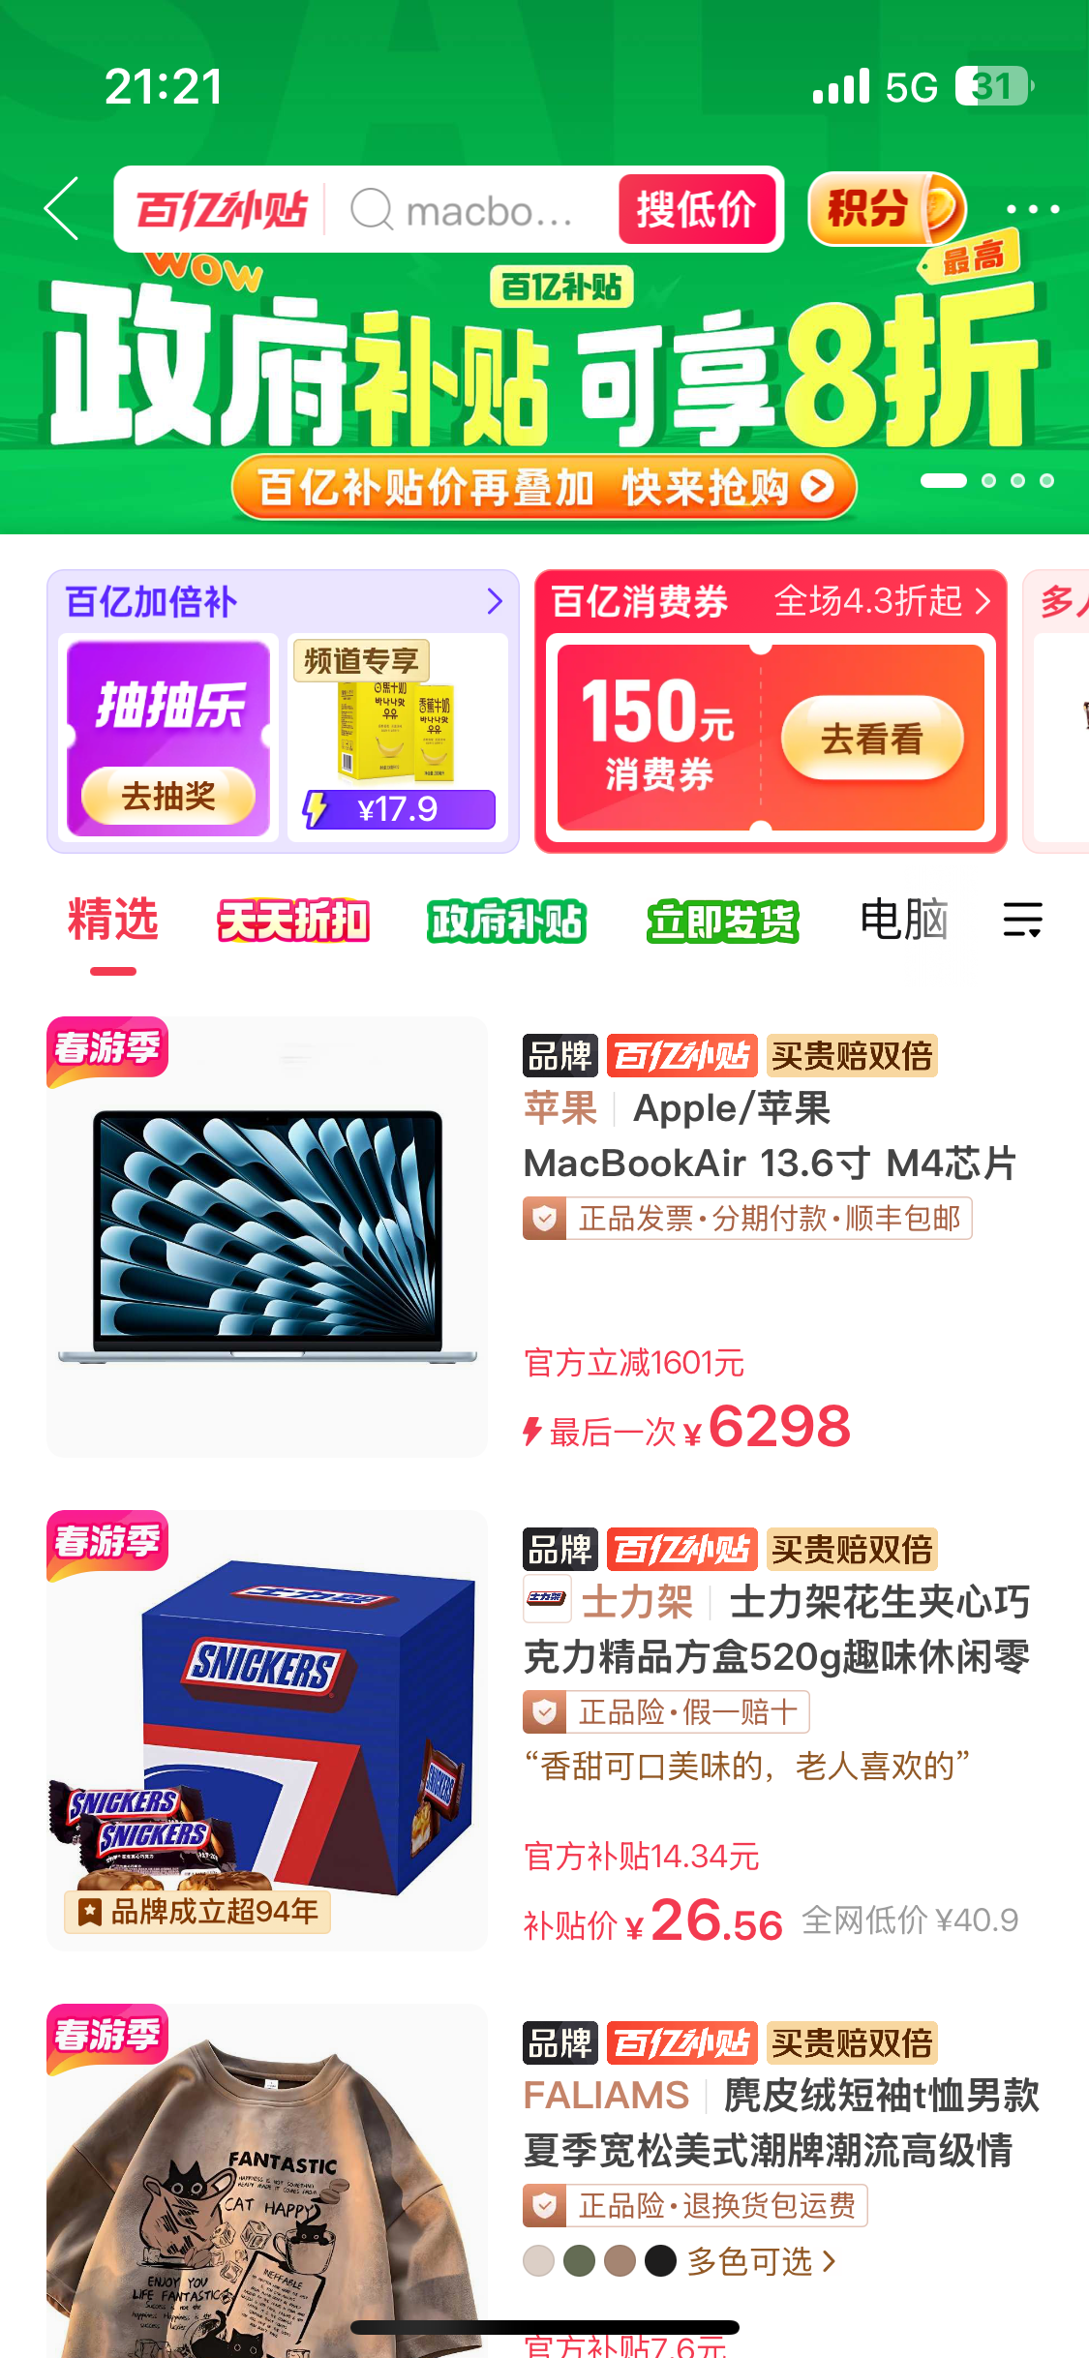
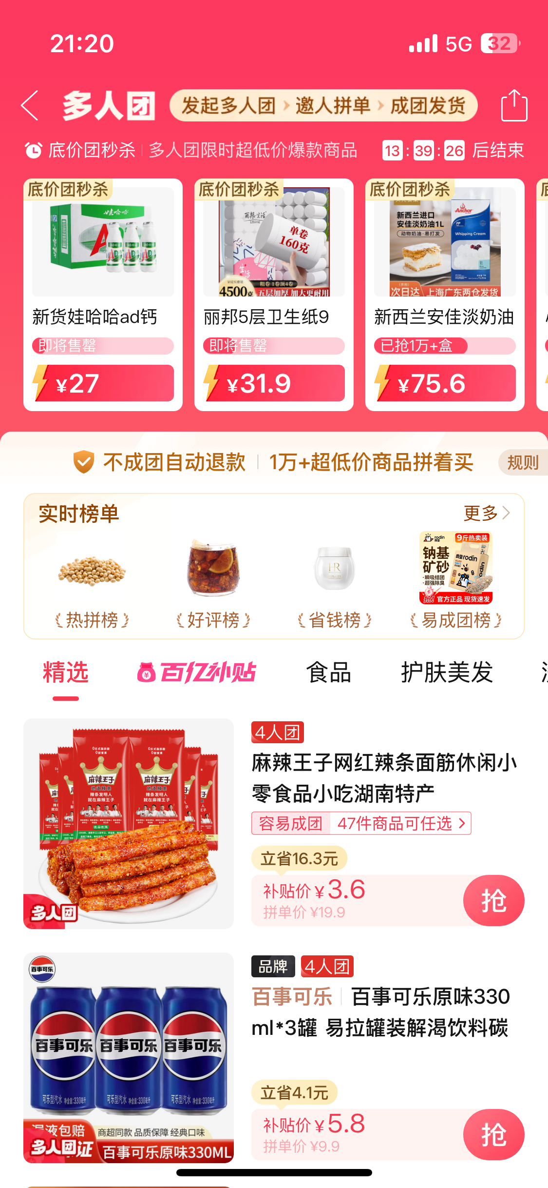
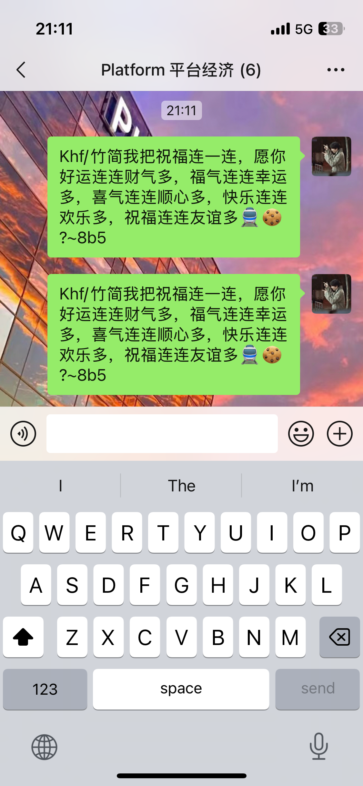
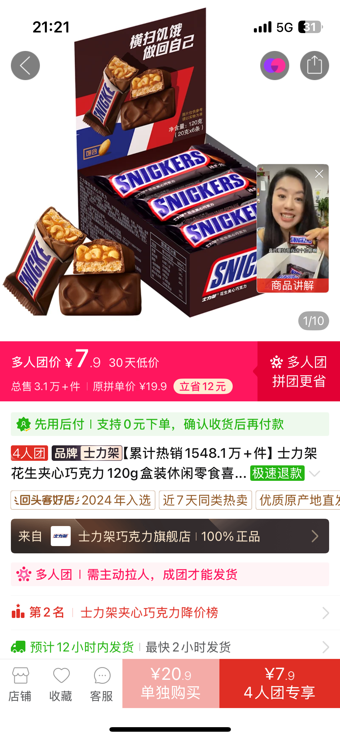
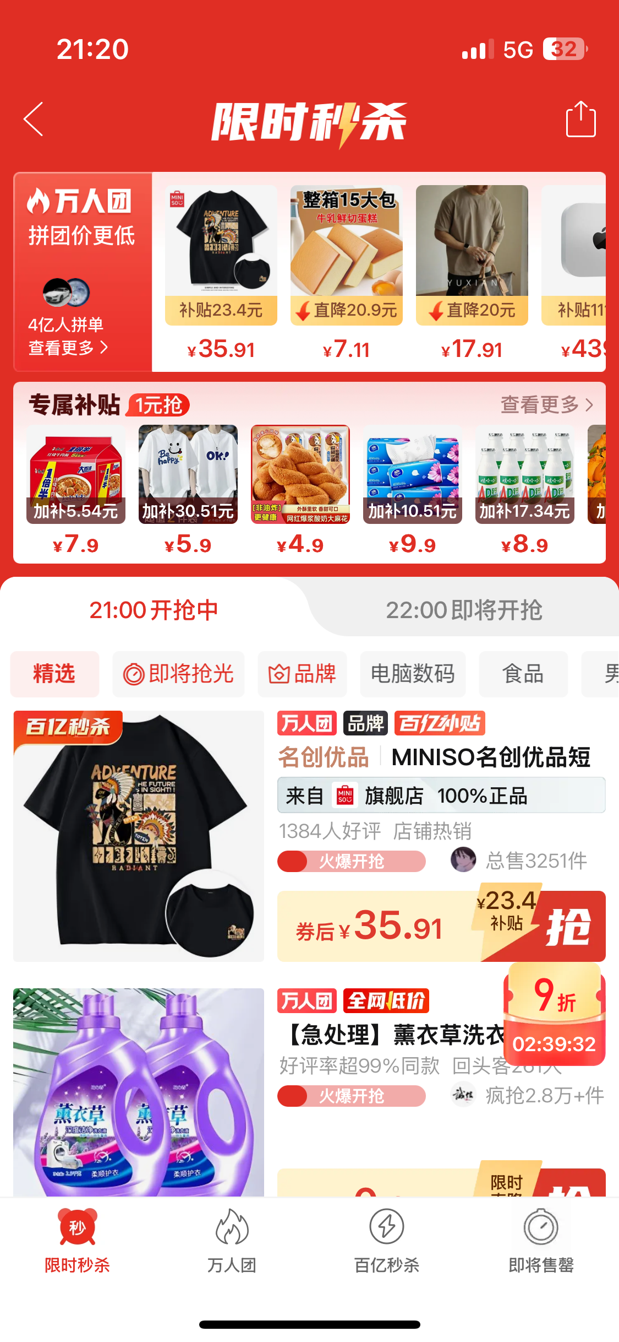
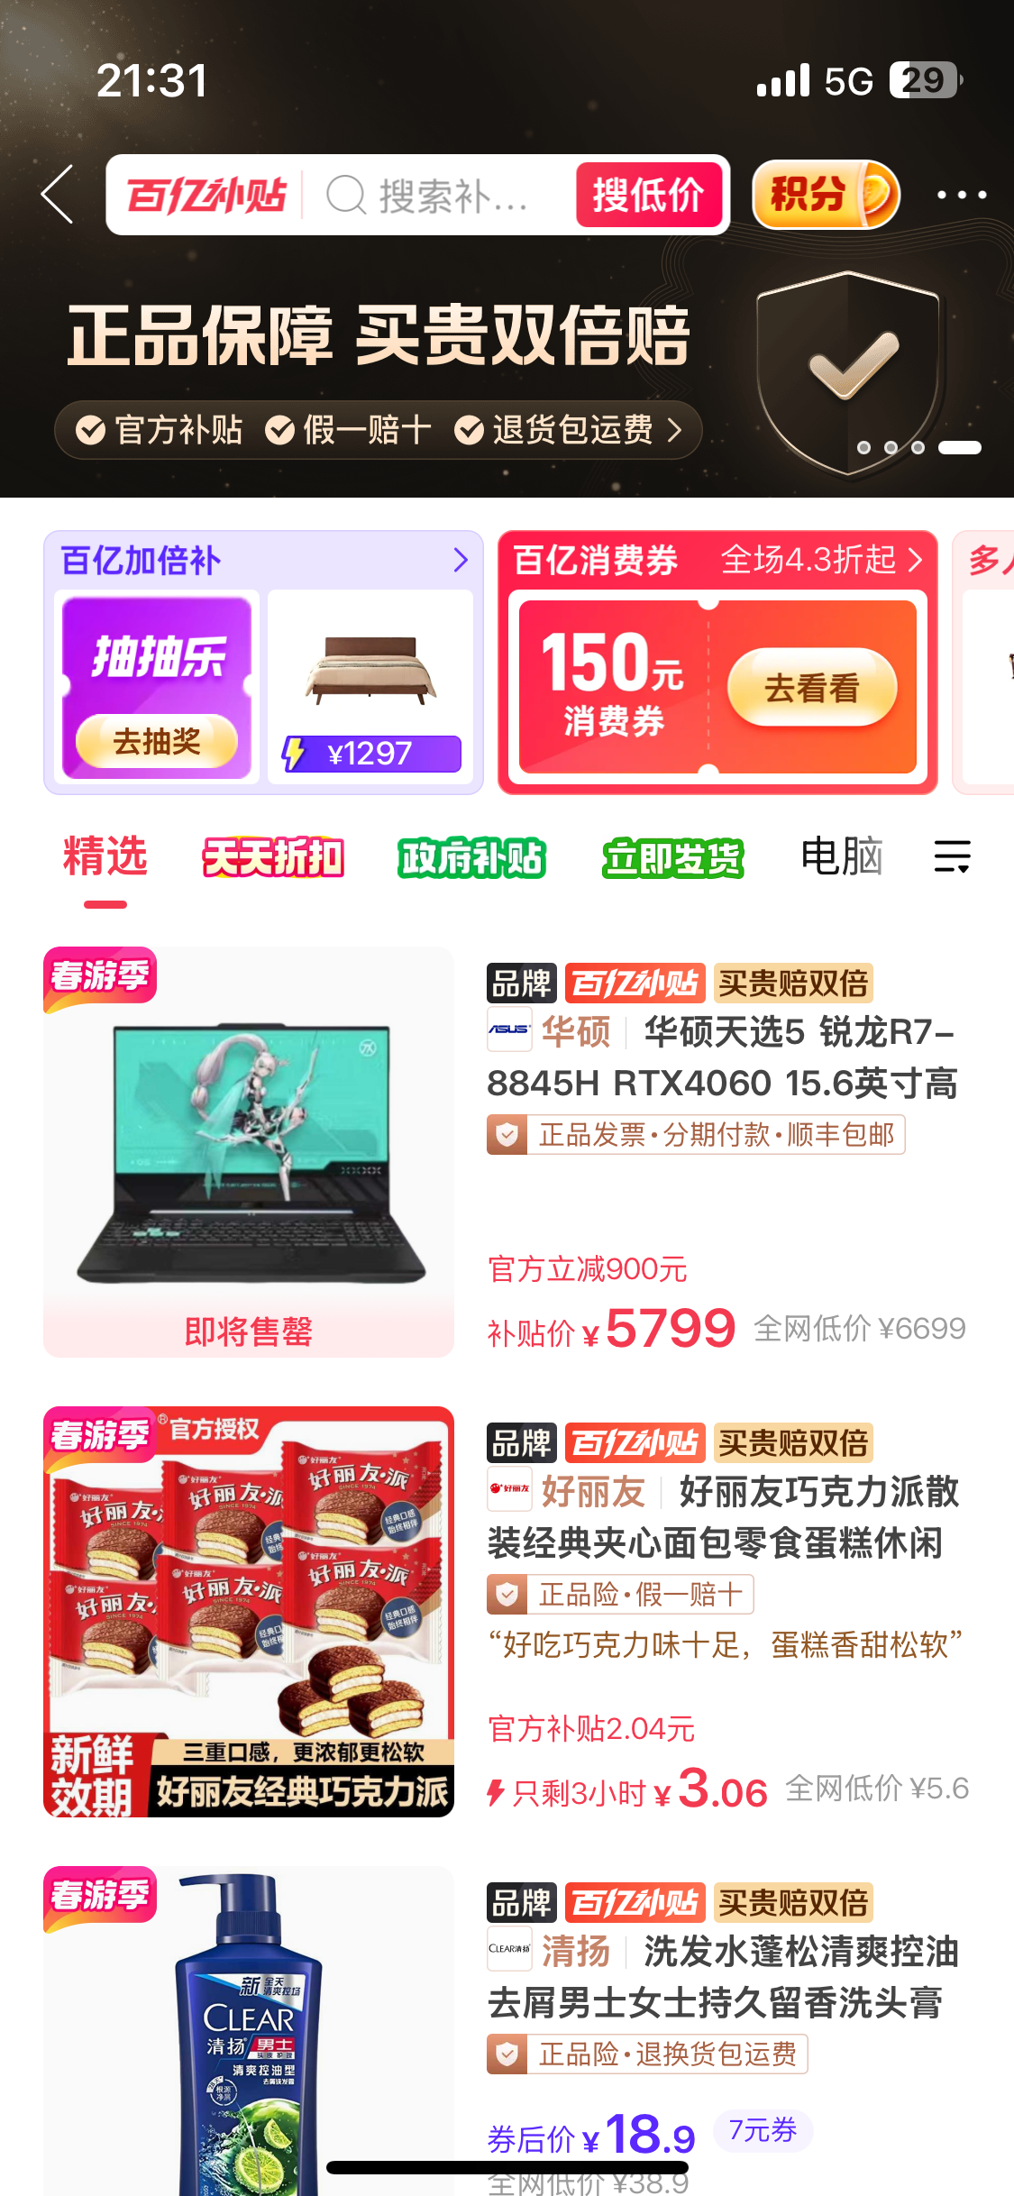
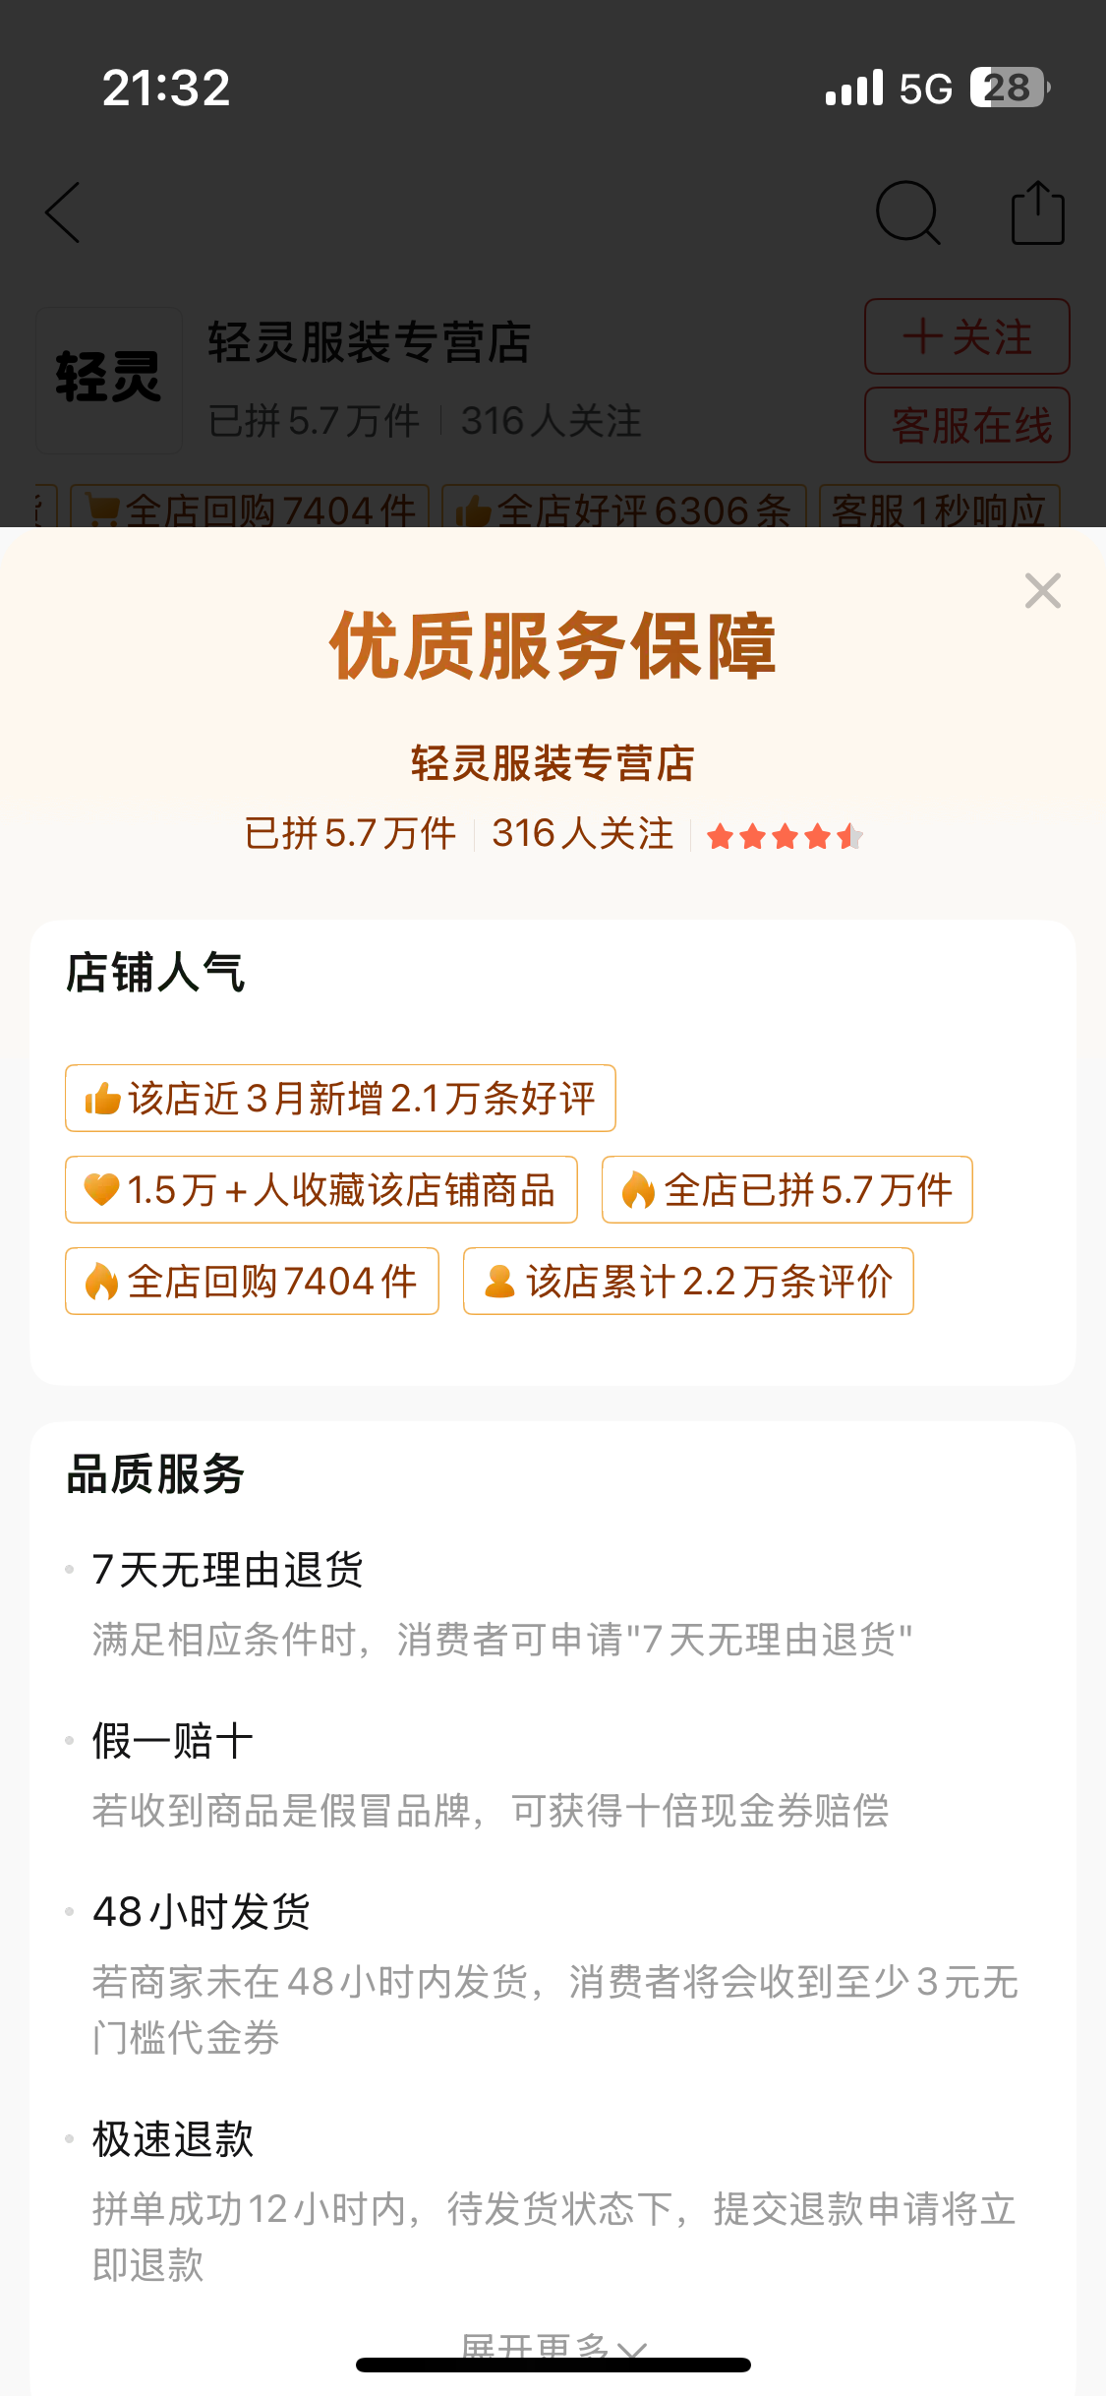
1.3 Platform Overview
14 primary classifications for searching.
Circle of Friends in PDD to build friendships.
Recommendation System
Invite Friends
for Cash
Network Effect
Online
Reputation
Platform Pricing
6

Slide 7
Project Framework
WeChat Traffic
PDD Introduction
Why PDD Take Off ?
PDD "Goods Find People"
Team Up for Low Price Logic
Theoretical Analysis
How does PDD deal with the problem of fakes ?
1. Network Effect
2. Platform Pricing
User
Initial
Group Buying
Group Buying Formation
Group Buying Formation
3. Online
Reputation
4. Recommendation
System
Aggregated
Demand​​
Small Profits
but
Quick Turnover​​
Social Fission
Join
Group Buying
Extension
Can PDD‘s path to success be replicated ?
What is the future direction of PDD ?
​​Third-Party Logistics
Conclusion
7

Slide 8
PART 02
Theoretical
Analysis
PINDUODUO
Team Up, Price Down!
Team Up for Savings | Deals | Welcome Surprises !

Slide 9

2.1.1 Direct and Indirect Network Effects Overview
attract flow
Relying on WeChat's huge flow
Existing/seed users
“grouping” is easy to realize
A) Attract Flow
Sinking market socialization is tight
B)Customer Acquisition
Diversifica-tion of products & low prices
Mass production by merchants
Demand Aggregation
More user attraction and retention
More user attraction and retention
Stronger competition among merchants
Attract more merchants
C)Customer Rentention
A) Attract Flow→B)Customer Acquisition＝Direct Network Effects B) Customer Acquisition→C)Customer Rentention = Indirect Network Effects

Slide 10



2.1.2 Direct Network Effects
attract flow
Relying on WeChat's huge flow
“grouping” is easy to realize
More user attraction and retention
Existing/seed users
A) Attract Flow
B)Customer Acquisition
Sinking market socialization is tight
WeChat for Attraction
01
Core Strategy: Group Buying
02
Social E-commerce Fission Growth Model
03
Easy Sign-Up via WeChat
Seamless Integration (Mini Program)
Viral Spread & Low-Cost Sharing via WeChat
User Motivation: Price Savings > Social Effort
Target: Price-Sensitive "Sinking Market"
Amplified by Tight Social Circles
Key Tactics: Employs viral mechanics like Bargain Slash, sharing red packets, and group buying with acquaintances.
Outcome: reducing Customer Acquisition Cost (CAC).

Slide 11
2.1.3 Indirect Network Effects
attract flow
Diversifica-tion of products & low prices
Mass production by merchants
Demand Aggregation
More user attraction and retention
More user attraction and retention
Stronger competition among merchants
Attract more merchants
C)Customer Rentention
B)Customer Acquisition
User Retention Strategy
Low Price Focus
Gamification & Real Rewards
Network Effects Evolution
Enhancing User Value
"Billion Subsidies"
Attracting Merchants

Slide 12

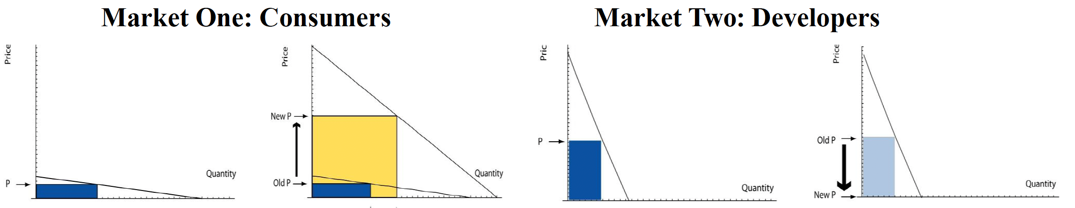
2.2.1 Divide-and-conquer strategy
PDD dominates China's e-commerce through social group buying and direct factory sales. By cutting middlemen and using WeChat's network, it delivers ultra-low prices to cost-conscious shoppers nationwide. Its C2M model and gamified promotions make online shopping affordable across all city tiers.
Platform | Profit making group | Subsidized group
PDD | Merchants | Consumers

Slide 13
2.2.1 Divide-and-conquer strategy
Why do platforms have the ability to adopt this pricing strategy ?
01
02
03
04
Attract Sellers
Reduce Costs
Squeeze
Supplier Margins
Subsidize Users
Low-Cost Entry & Traffic Support
Streamlined Supply Chain
Viral Discounts & “Lowest Price” Branding
Strict Pricing Control
Zero/low fees: Early no-commission policy (later minimal fees) lowers entry barriers.
Social traffic: Group-buying via WeChat enables viral exposure without ads.
Farmers’ support: Zero fees, logistics aid, and traffic priority for direct farm-to-consumer sales.
Bid-based ranking: Sellers compete on price for visibility.
Bulk order discounts: Group buys lock in lower supplier prices.
Penalties: Fines for delays/defects balance low prices with reliability.
“Billions Subsidies”: Discounts on iPhones/Dyson to attract premium shoppers.
Social sharing: Group buys/referral discounts drive low-cost acquisition.
Gamification: E.g., “Duo Duo Orchard” rewards engagement with free produce.
C2M model: Direct factory-to-consumer sales, using data to guide production.
Simplified marketing: Algorithm-driven “goods-find-people” promotions cut ad costs.
3PL logistics: Outsourced delivery with bulk discounts.

Slide 14
2.2.1 Divide-and-conquer strategy
PDD
Commodity profit
More user scale
On PDD, pricing depends not only on the demand and cost from marginal cost and elasticity of demand, but also on how their participation affects participation on the other side, and the profits associated with the other side.
Network effect externalities
Low price attraction
Enjoy the product
Merchants
Consumers
Make money

Slide 15
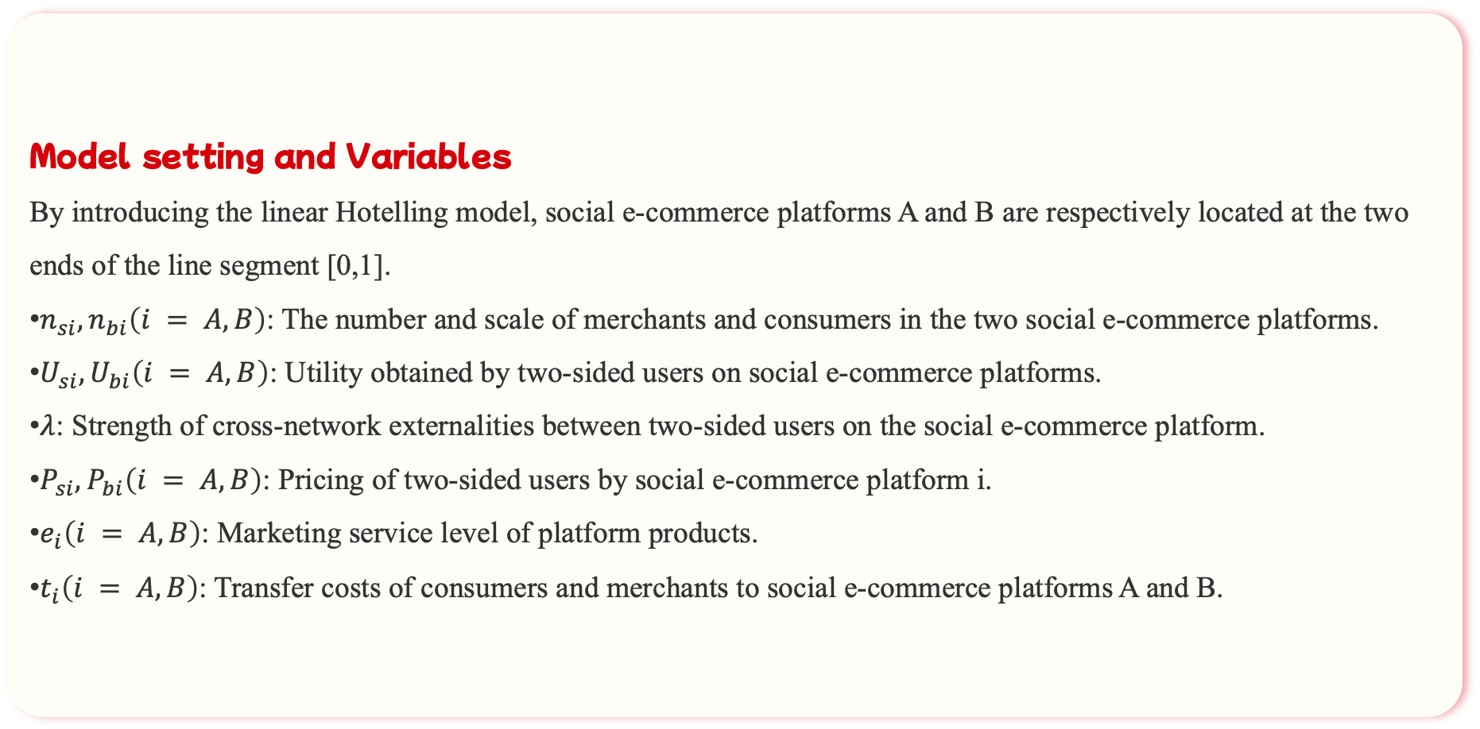
2.2.2 Two-sided Market Pricing
Model setting and Variables
By introducing the linear Hotelling model, social e-commerce platforms A and B are respectively located at the two ends of the line segment [0,1].
$n_{si},n_{bi}\left(i = A, B\right)$: The number and scale of merchants and consumers in the two social e-commerce platforms.
$U_{si},U_{bi}\left(i = A, B\right)$: Utility obtained by two-sided users on social e-commerce platforms.
$λ$: Strength of cross-network externalities between two-sided users on the social e-commerce platform.
$P_{si},P_{bi}\left(i = A, B\right)$: Pricing of two-sided users by social e-commerce platform i.
$e_{i}\left(i = A, B\right)$: Marketing service level of platform products.
$t_{i}\left(i = A, B\right)$: Transfer costs of consumers and merchants to social e-commerce platforms A and B.

Slide 16
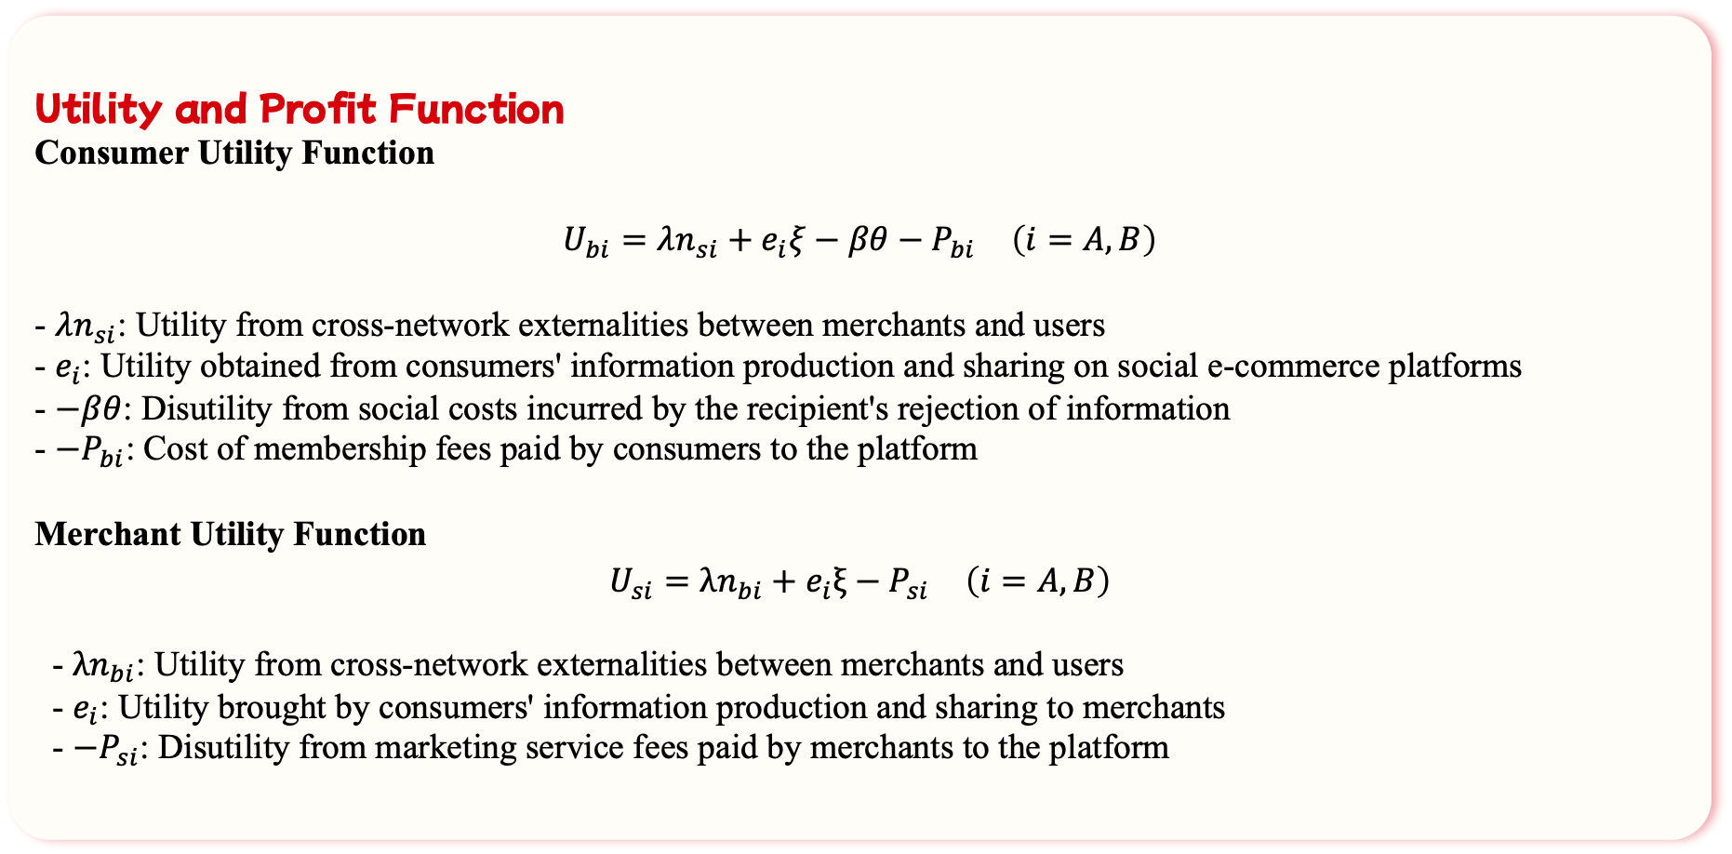
2.2.2 Two-sided Market Pricing
Utility and Profit Function
Consumer Utility Function
$$U_{bi}=λn_{si}+e_{i}ξ−βθ−P_{bi} \left(i=A,B\right)$$
- $λn_{si}$: Utility from cross-network externalities between merchants and users
- $e_{i}$: Utility obtained from consumers' information production and sharing on social e-commerce platforms
- $−βθ$: Disutility from social costs incurred by the recipient's rejection of information
- $−P_{bi}$: Cost of membership fees paid by consumers to the platform
Merchant Utility Function
$$U_{si}=λn_{bi}+e_{i}ξ−P_{si} \left(i=A,B\right)$$
- $λn_{bi}$: Utility from cross-network externalities between merchants and users
- $e_{i}$: Utility brought by consumers' information production and sharing to merchants
- $−P_{si}$: Disutility from marketing service fees paid by merchants to the platform

Slide 17
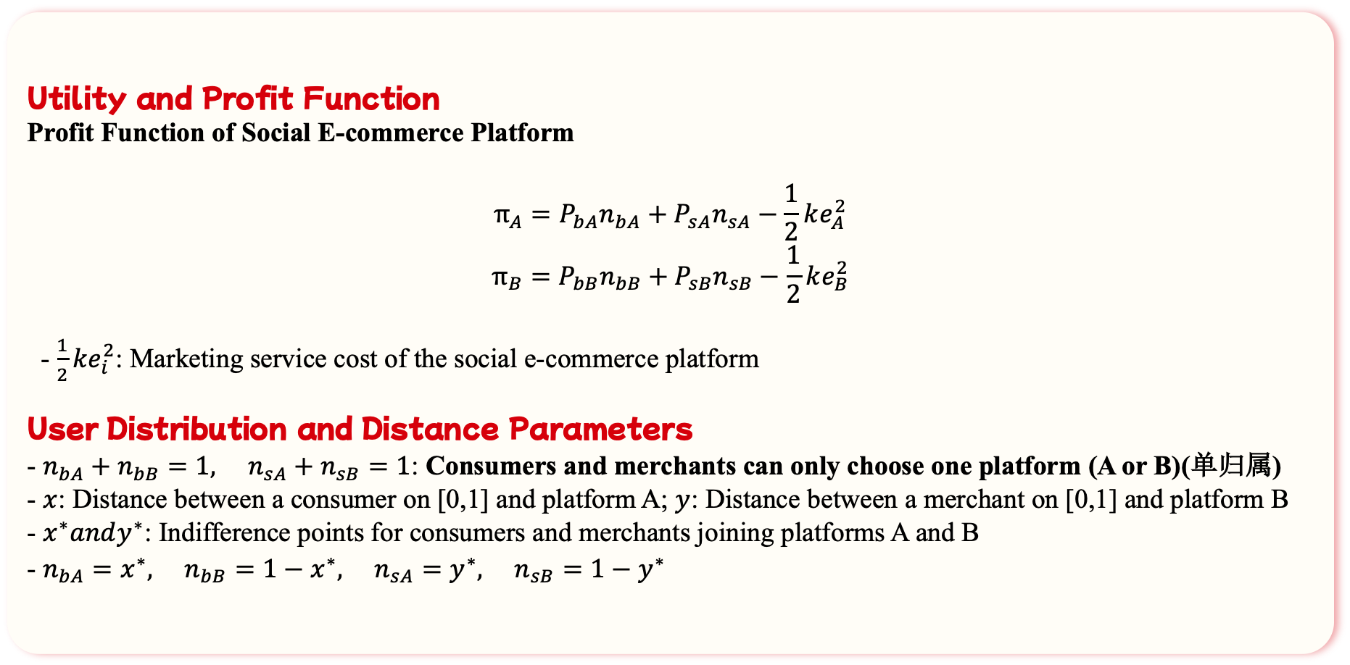
2.2.2 Two-sided Market Pricing
Utility and Profit Function
Profit Function of Social E-commerce Platform
$$π_{A}=P_{bA}n_{bA}+P_{sA}n_{sA}−\frac{1}{2}ke_{A}^{2}$$
$$π_{B}=P_{bB}n_{bB}+P_{sB}n_{sB}−\frac{1}{2}ke_{B}^{2}$$
- $\frac{1}{2}ke_{i}^{2}$: Marketing service cost of the social e-commerce platform
User Distribution and Distance Parameters
- $n_{bA}+n_{bB}=1, n_{sA}+n_{sB}=1$: Consumers and merchants can only choose one platform (A or B)(单归属)
- $x$: Distance between a consumer on [0,1] and platform A; $y$: Distance between a merchant on [0,1] and platform B
- $x^{∗}andy^{∗}$: Indifference points for consumers and merchants joining platforms A and B
- $n_{bA}=x^{∗}, n_{bB}=1−x^{∗}, n_{sA}=y^{∗}, n_{sB}=1−y^{∗}$

Slide 18
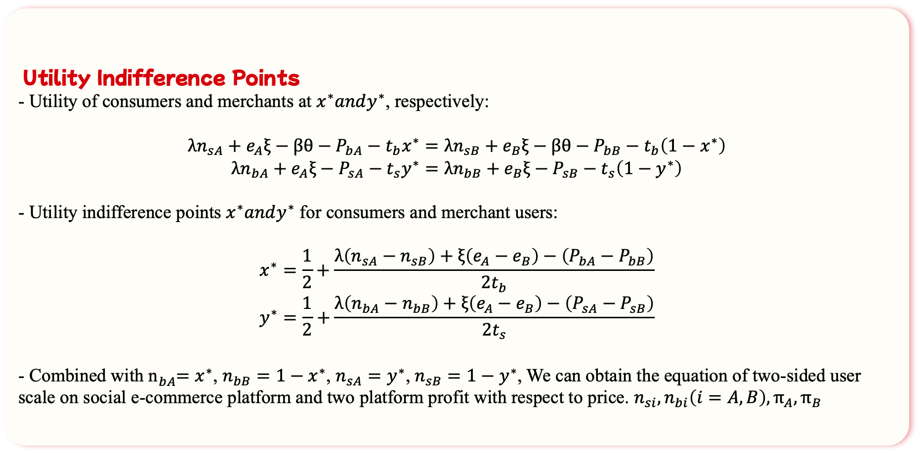
2.2.2 Two-sided Market Pricing
Utility Indifference Points
- Utility of consumers and merchants at $x^{∗}andy^{∗}$, respectively:
$$λn_{sA}+e_{A}ξ−βθ−P_{bA}−t_{b}x^{∗}=λn_{sB}+e_{B}ξ−βθ−P_{bB}−t_{b}\left(1−x^{∗}\right)$$
$$λn_{bA}+e_{A}ξ−P_{sA}−t_{s}y^{∗}=λn_{bB}+e_{B}ξ−P_{sB}−t_{s}\left(1−y^{∗}\right)$$
- Utility indifference points $x^{∗}andy^{∗}$ for consumers and merchant users:
$$x^{∗}=\frac{1}{2}+\frac{λ\left(n_{sA}−n_{sB}\right)+ξ\left(e_{A}−e_{B}\right)−\left(P_{bA}−P_{bB}\right)}{2t_{b}}$$
$$y^{∗}=\frac{1}{2}+\frac{λ\left(n_{bA}−n_{bB}\right)+ξ\left(e_{A}−e_{B}\right)−\left(P_{sA}−P_{sB}\right)}{2t_{s}}$$
- Combined with n${}_{bA}^{}=x^{∗}$, $n_{bB}=1−x^{∗}$, $n_{sA}=y^{∗}$, $n_{sB}=1−y^{∗}$, We can obtain the equation of two-sided user scale on social e-commerce platform and two platform profit with respect to price. $n_{si},n_{bi}\left(i=A,B\right),π_{A},π_{B}$

Slide 19
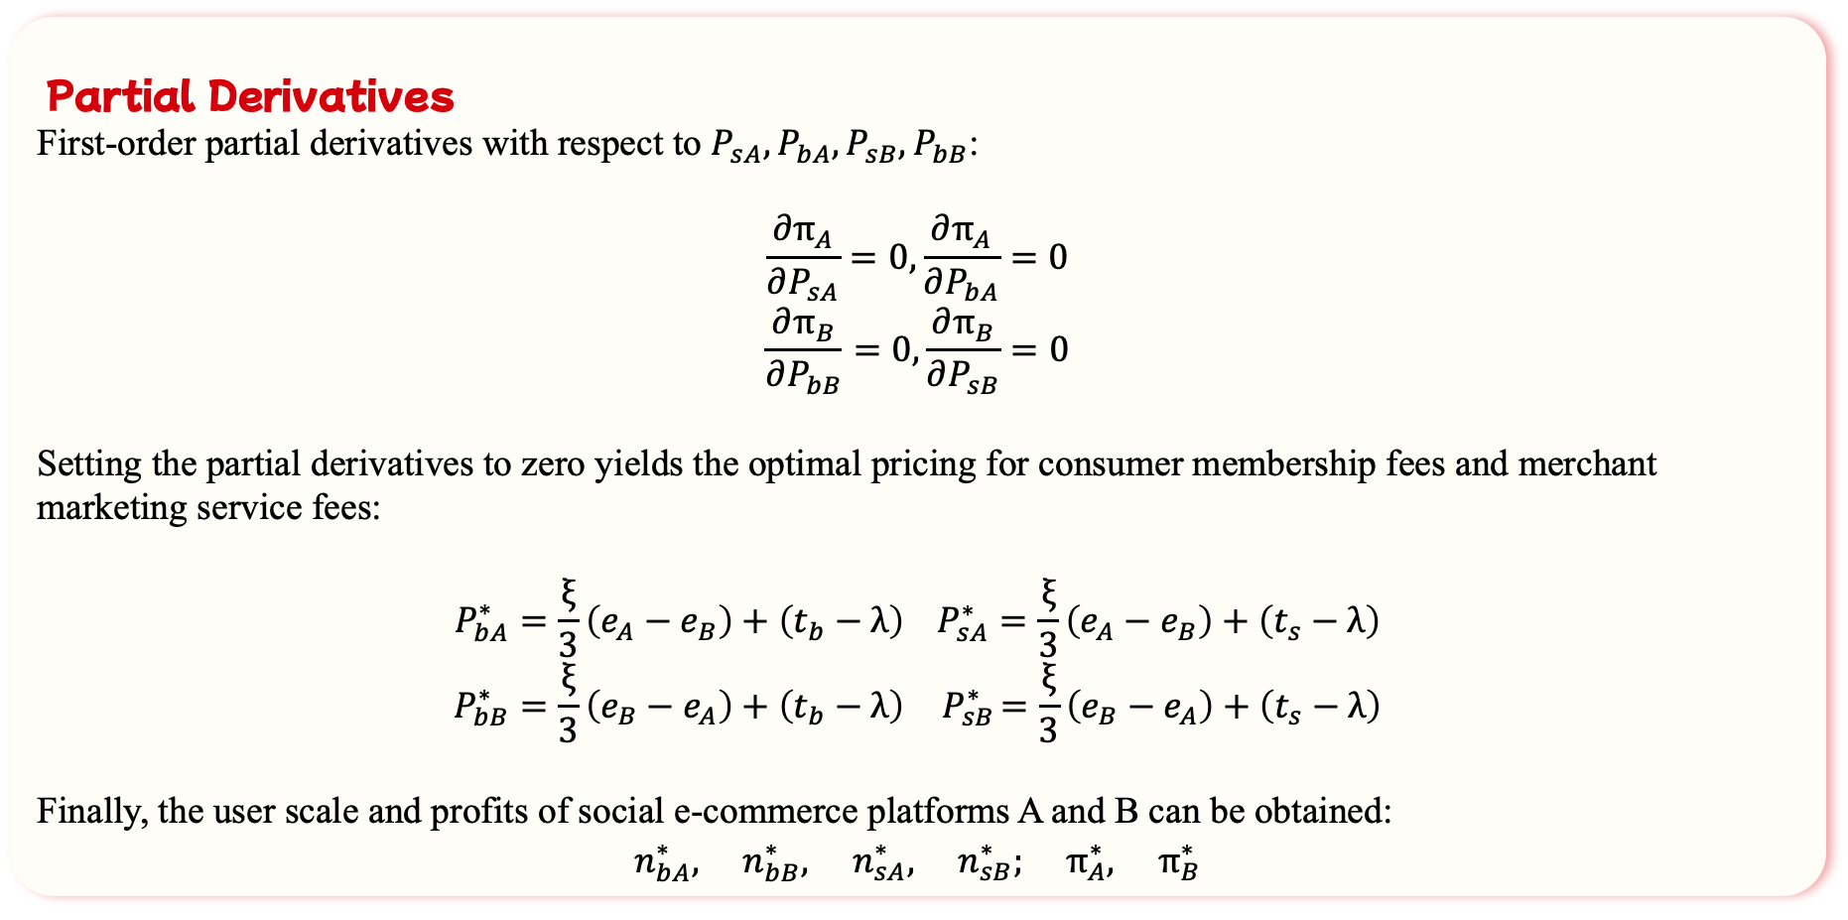
2.2.2 Two-sided Market Pricing
Partial Derivatives
First-order partial derivatives with respect to $P_{sA},P_{bA},P_{sB},P_{bB}$:
$$\frac{∂π_{A}}{∂P_{sA}}=0,\frac{∂π_{A}}{∂P_{bA}}=0$$
$$\frac{∂π_{B}}{∂P_{bB}}=0,\frac{∂π_{B}}{∂P_{sB}}=0$$
Setting the partial derivatives to zero yields the optimal pricing for consumer membership fees and merchant marketing service fees:
$$P_{bA}^{∗}=\frac{ξ}{3}\left(e_{A}−e_{B}\right)+\left(t_{b}−λ\right) P_{sA}^{∗}=\frac{ξ}{3}\left(e_{A}−e_{B}\right)+\left(t_{s}−λ\right)$$
$$P_{bB}^{∗}=\frac{ξ}{3}\left(e_{B}−e_{A}\right)+\left(t_{b}−λ\right){ P}_{sB}^{∗}=\frac{ξ}{3}\left(e_{B}−e_{A}\right)+\left(t_{s}−λ\right)$$
Finally, the user scale and profits of social e-commerce platforms A and B can be obtained:
$$n_{bA}^{∗}, n_{bB}^{∗}, n_{sA}^{∗}, n_{sB}^{∗}; π_{A}^{∗}, π_{B}^{∗}$$

Slide 20
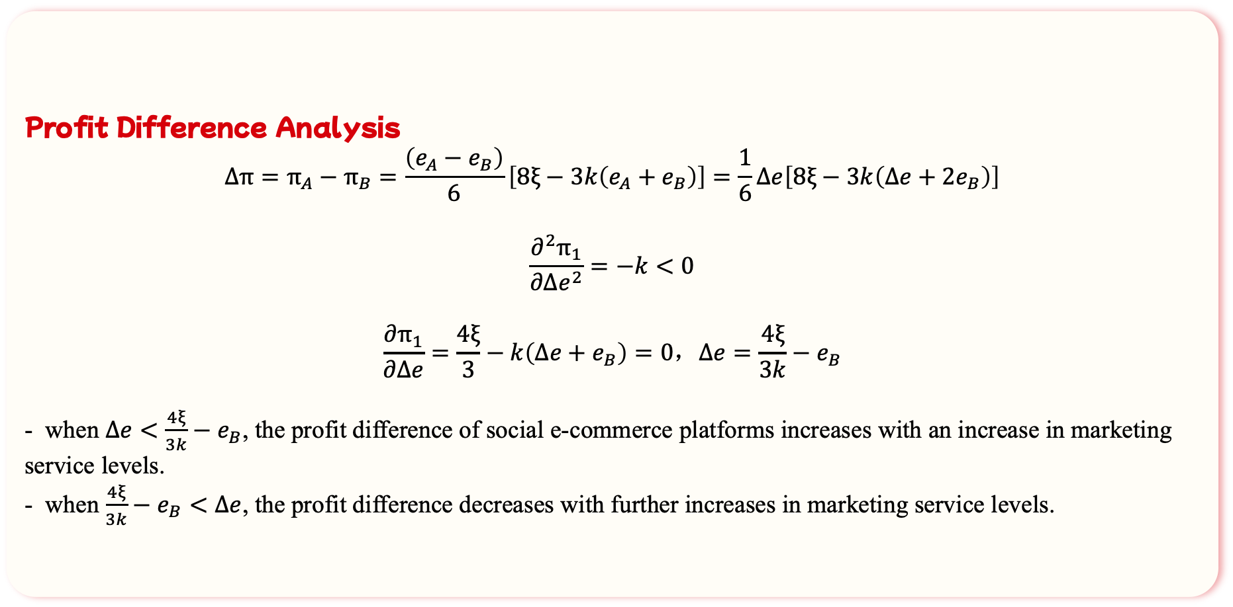
2.2.2 Two-sided Market Pricing
Profit Difference Analysis
$$Δπ=π_{A}−π_{B}=\frac{\left(e_{A}−e_{B}\right)}{6}\left[8ξ−3k\left(e_{A}+e_{B}\right)\right]=\frac{1}{6}Δe\left[8ξ−3k\left(Δe+2e_{B}\right)\right]$$
$$\frac{∂^{2}π_{1}}{∂Δe^{2}}=−k<0$$
$$\frac{∂π_{1}}{∂Δe}=\frac{4ξ}{3}−k\left(Δe+e_{B}\right)=0，Δe=\frac{4ξ}{3k}−e_{B}$$
- when $Δe<\frac{4ξ}{3k}−e_{B}$, the profit difference of social e-commerce platforms increases with an increase in marketing service levels.
- when $\frac{4ξ}{3k}−e_{B}<Δe$, the profit difference decreases with further increases in marketing service levels.

Slide 21
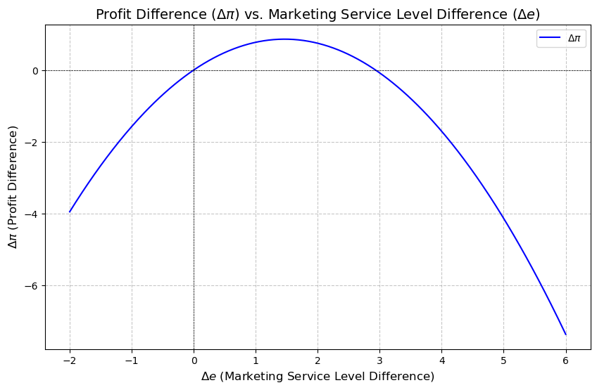
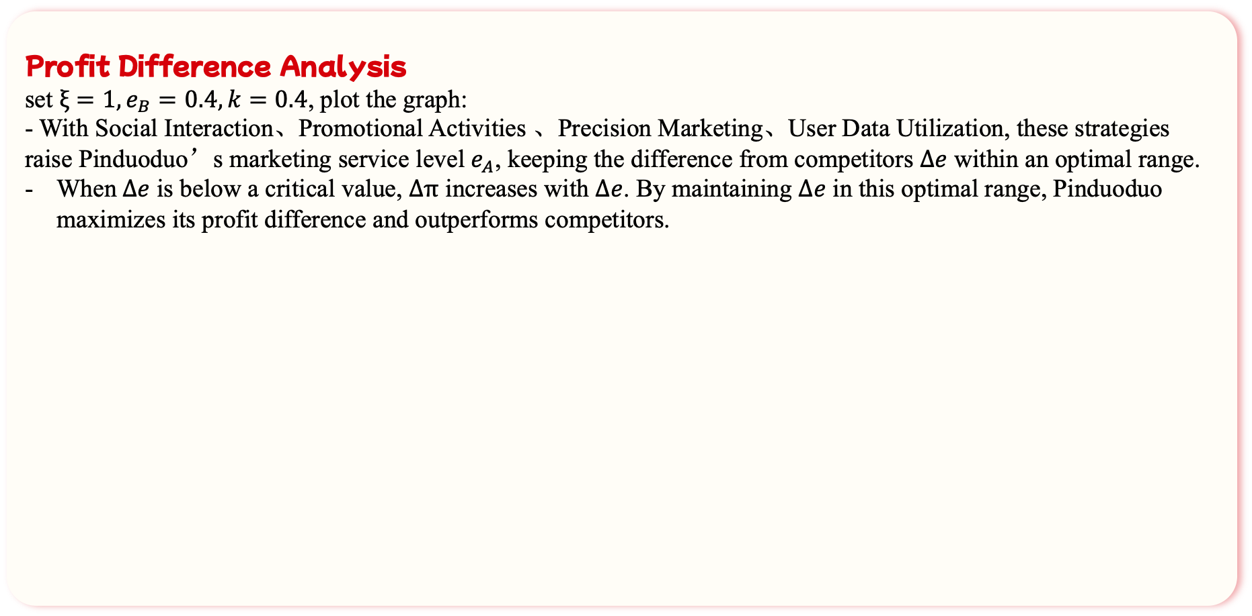
2.2.2 Two-sided Market Pricing
Profit Difference Analysis
set $ξ=1,e_{B}=0.4,k=0.4$, plot the graph:
- With Social Interaction、Promotional Activities 、Precision Marketing、User Data Utilization, these strategies raise Pinduoduo’s marketing service level $e_{A}$, keeping the difference from competitors $Δe$ within an optimal range.
When$Δe$ is below a critical value, $Δπ$ increases with $Δe$. By maintaining $Δe$ in this optimal range, Pinduoduo maximizes its profit difference and outperforms competitors.

Slide 22
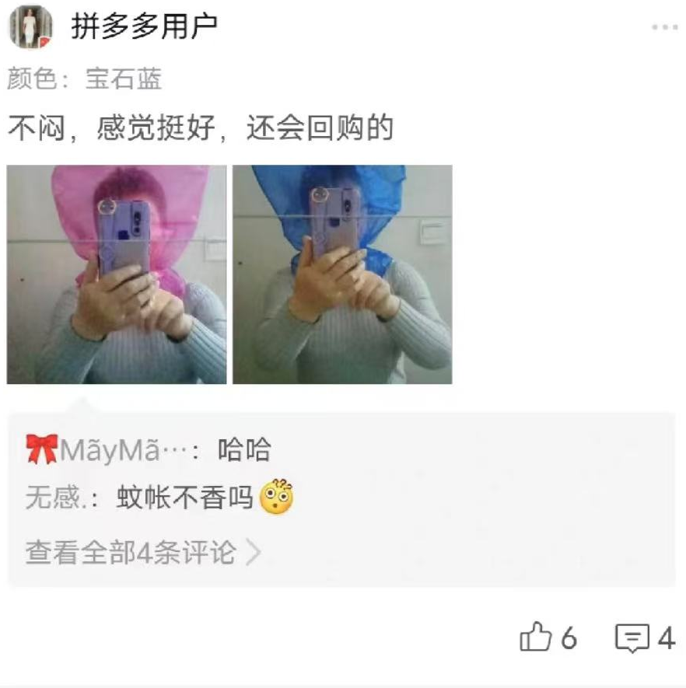
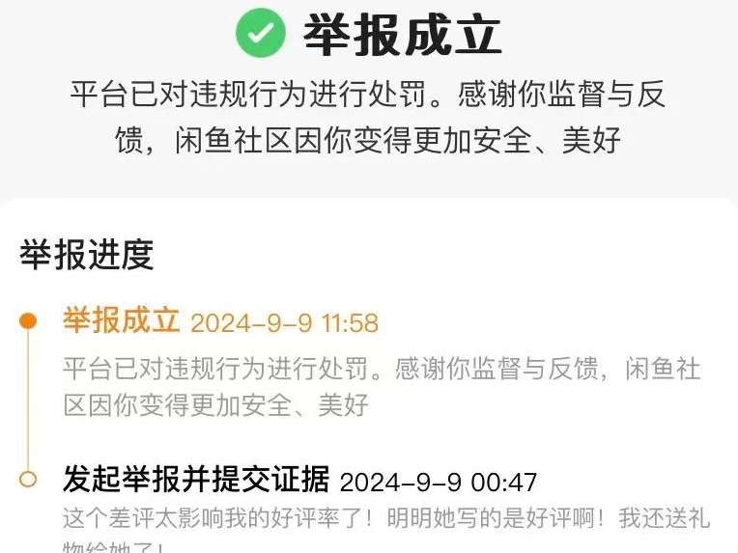
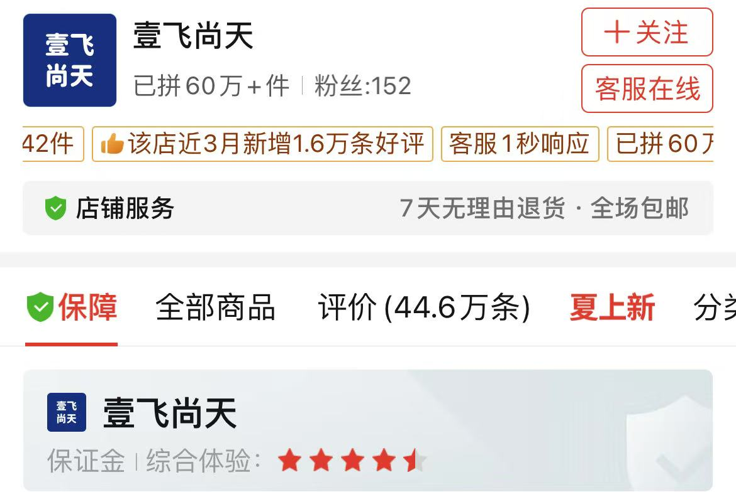
2.3.1 Procedure of the online reputation system
01
02
03
Buyer
Seller
Platform
Purchase
rate💯
review rating
low rating governance
DSR index
Signal
report⚠️
Service(40%)Product(40%)Logistics(20%)
Store will be degraded if DSR < 4.5
like👍
comment
optimize product
By reducing search cost, rating helps to reduce adverse selection.

Slide 23
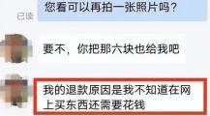
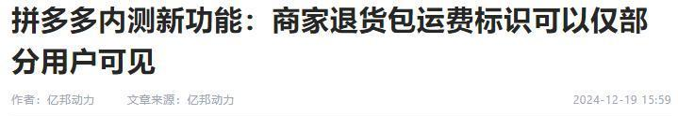


2.3.2 Risk of online reputation system
problem
solution
Buyer: "Refund only"policy
“Selected user plan”
The buyer can buy goods impulsively and reject the delivery, resulting in the loss of seller's 2rd freight.
Filter out high- quality users and eliminate low- quality ones who engage in wool- harvesting. (薅羊毛)
Seller：counterfeit goods
“New brand plan2.0” + “Billion subsidy”
A large number of merchants to settle in and provide a rich variety of goods, but in order to pursue low prices and high sales, the requirements for product quality are relaxed to a certain extent.
Build sub- brand of well- known brands, support new brands in the industrial belt and reconstruct old domestic brands.
The key category covered in billion subsidy is digital 3C, creating the lowest omni- channel price and authentic reputation.
Head e-commerce complaints

Slide 24
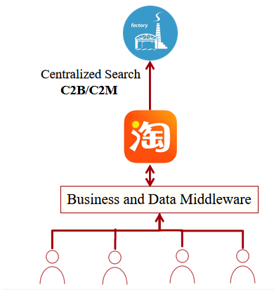
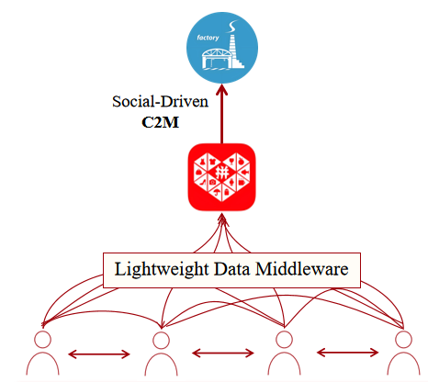
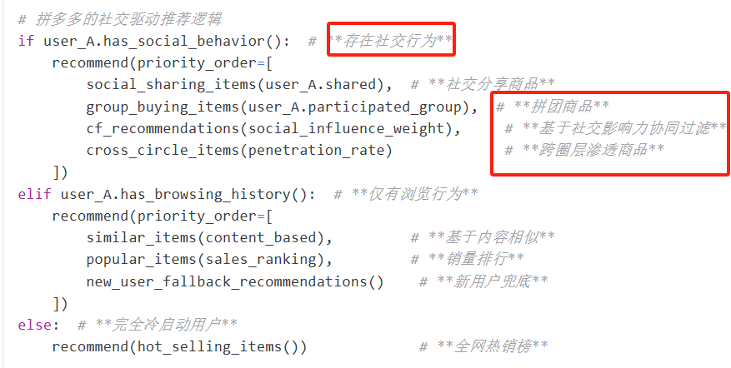
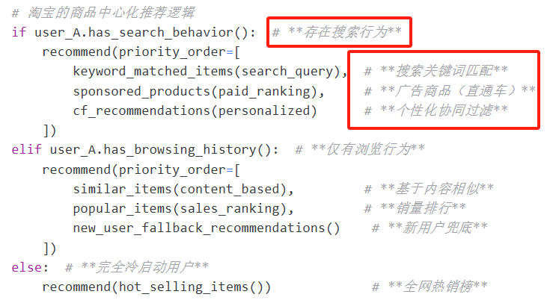

2.4.1 Recommended Matching System
Both Content-based Filtering
+Collaborative Filtering
PDD
1.Collaborative Filtering(More Social influence weight) Better!
2.data: user A → sharing → user B → successful pintuan
Social weight (KOC)+Penetration rate across different social strata
Taobao
1.Collaborative Filtering(only based on behavioral similarities)
2.data:A buy X, B buy X+Y, recommend Y to A
Inability to obtain real social relationships
24

Slide 25
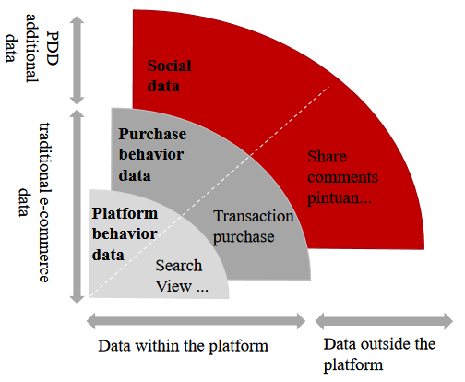
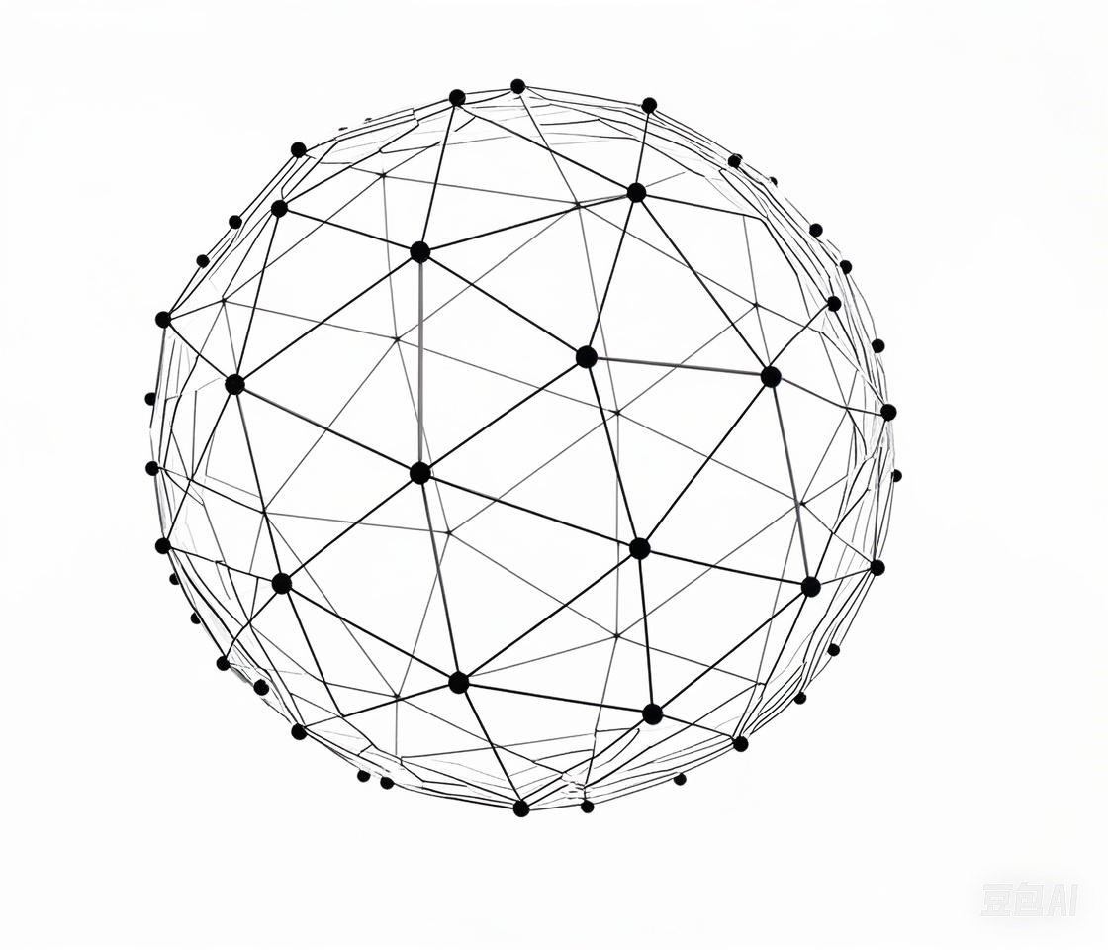
2.4.2 Algorithm differences
零售电商发展阶段
Data input
Distributed AI
1.Taobao: Platform centralization algorithm, focus on products to Collect, calculate, and distribute data.
2. PDD: people-oriented algorithm, use distributed AI can deeply understand users and enhance the algorithm by utilizing pintuan data and social relationships.
25

Slide 26
PART 03
Extension
PINDUODUO
Team Up, Price Down!
Team Up for Savings | Deals | Welcome Surprises !

Slide 28
PART 04
Conclusion
PINDUODUO
Team Up, Price Down!
Team Up for Savings | Deals | Welcome Surprises !

Slide 30
PINDUODUO
Thank You
April 18th, 2025
Group 1: Kai Ren, PeiHua Ji, JunWen Luo, FeiFan Xu,
Lei Cheng, Chang Li
Team Up, Price Down!
Team Up for Savings | Deals | Welcome Surprises !

